Slide 1
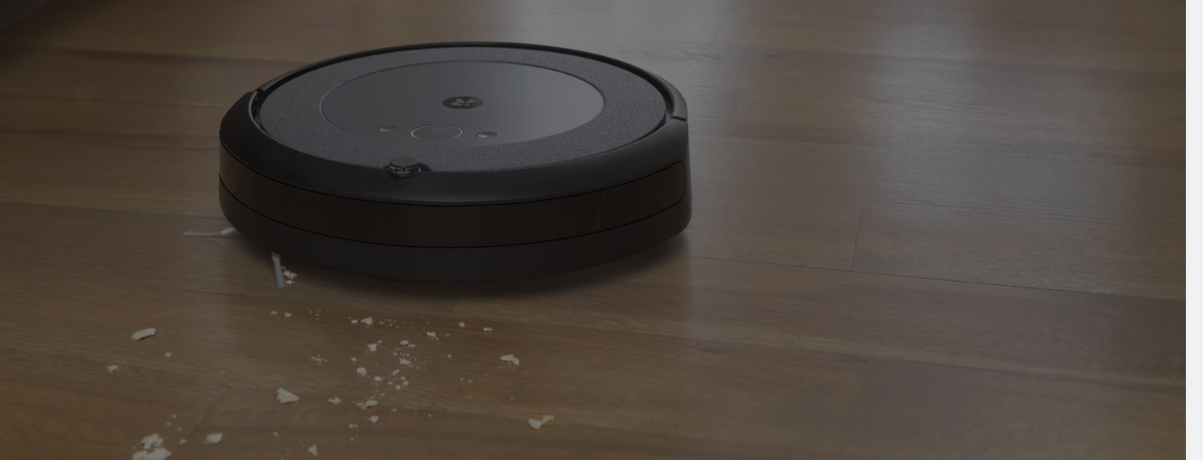
RVC
Robot Vacuum Cleaner

Slide 2
Design
Architecture
Low level design

Slide 3
Architecture
The basic idea is to use a layered style, to decouple the device drivers (that likely change often) from application logic (movement, mapping algorithms). The presentation layer is, presently, very simple (just 2 buttons), but it could be extended in the future
Layers are represented with packages.

Slide 4
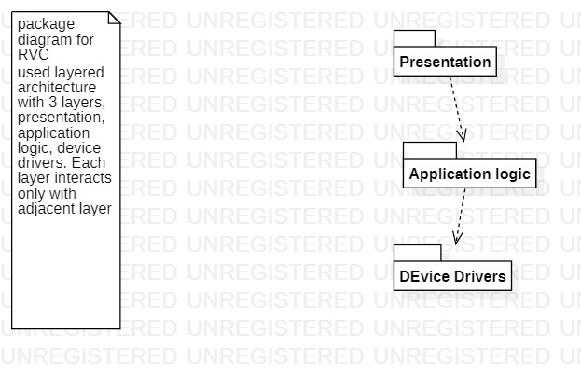

Slide 5
Low level design
Since there are few classes, one single class diagram is used, covering all packages
Each sensor / actuator has a corresponding class (device driver layer)
Consistent groups of functions are grouped (class motion manager, class energy manager etc) (application logic layer)
House map, path, tile, position, and of course robot, come from the glossary

Slide 6
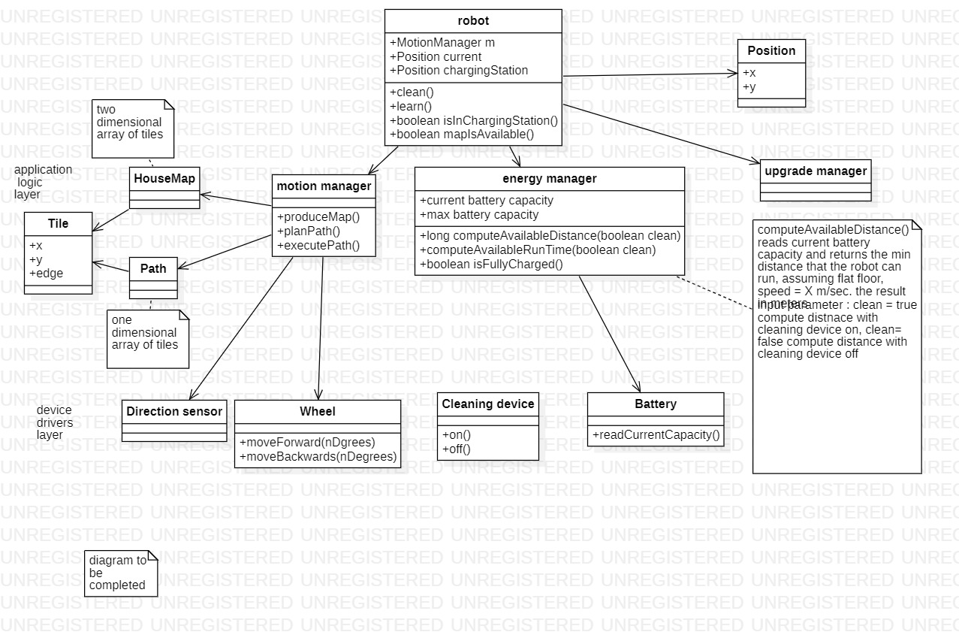

Slide 7
Low level design
Patterns that could be used to improve the design:
Adapter, for interfaces with device drivers
Strategy, for complex algorithms

